Slide 1
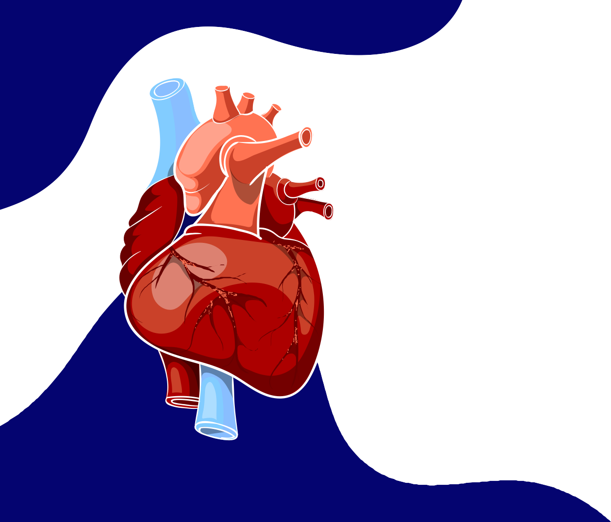

Detection of COVID-19 and
Cardiovascular Diseases By ECG

Slide 2







Our team
David Hanna
Aya Eid
Hager Hamed
Huda Gamal
Semon Mamdoh
Yara Salman Jonathan Ehab
Under Supervision:
Dr.. Mahmoud Bassiiounii
Eng.. Hayam Abdellbaset

Slide 3

OUTLINE
Introduction Motivation Problem statement Problem solutions Related work
Data Set
implementation Model Structure Methodology
Technologies
Time plan

Slide 4
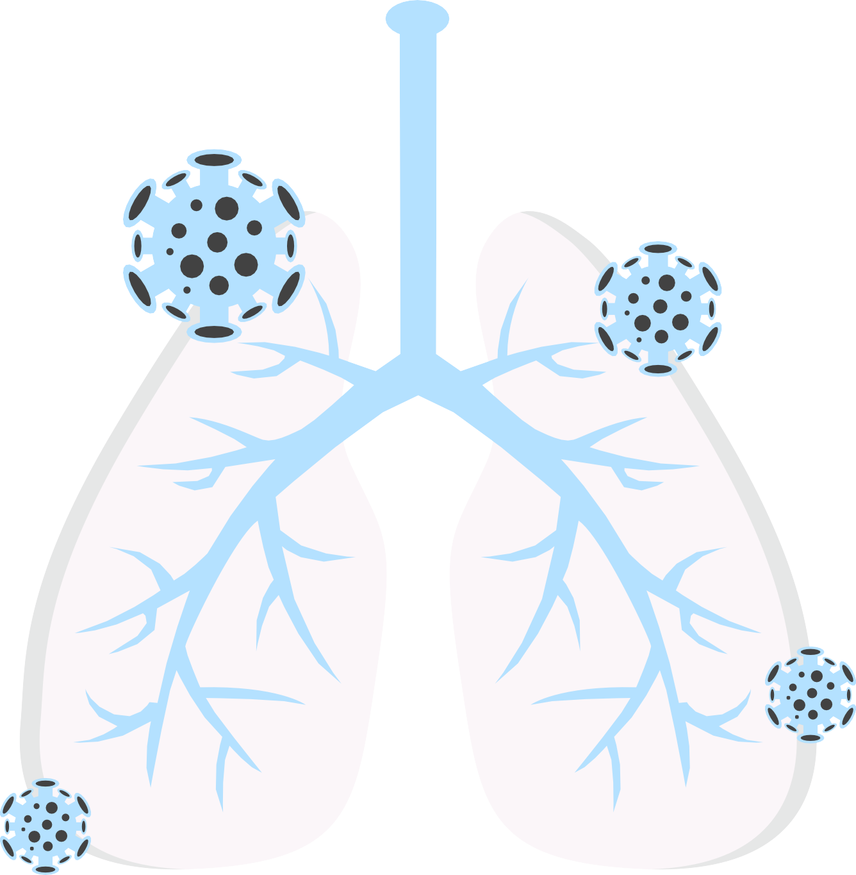
INTRODUCTION
01

Slide 5
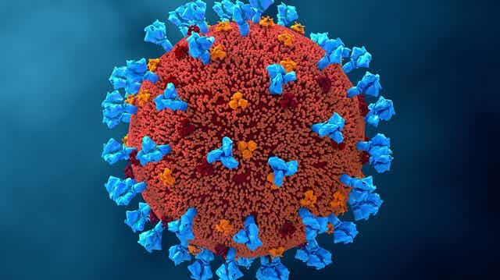
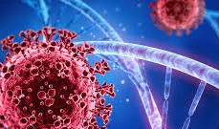
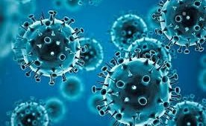
It was discovered recently that COVID_19 affects several organs in the human body, especially the cardiovascular system.
December 2019
March 2020
February 2023
753 million
6.8 million
The covide19 first appeared in China
It was noted that the number of deaths worldwide due to this virus was significant
according to a report presented by the World Health Organization
people were infected with this disease
deaths

Slide 6

It was estimated by the World Health Organization (WHO) in February 2023 that more than 17.9 million people are dying due to CVD
SOME OF THE DISEASES THAT CAN AFFECT THE HEART INCLUDE:
- Heart attack
- Myocarditis (inflammation of the heart
muscle)
Arrhythmias (heart rhythm disorders)
Cardiomyopathy (enlargement of the heart muscle)

Slide 7

02
Motivation

Slide 8
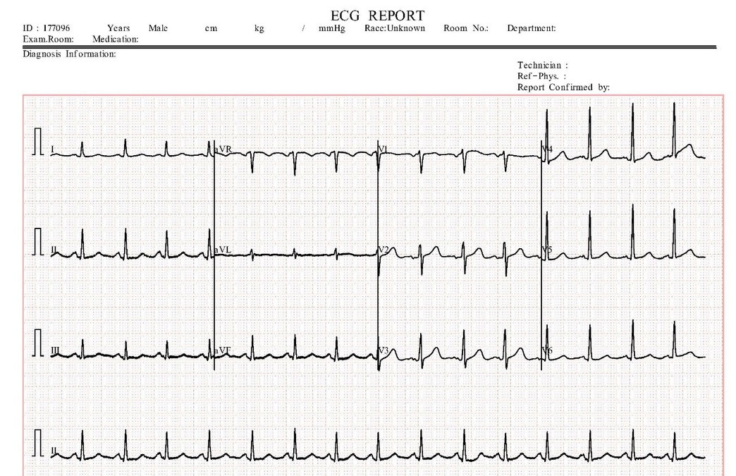
The motivation behind developing an application using ECG image for diagnosing heart diseases and COVID-19 is to enhance early diagnosis and provide effective healthcare.
This technology aids in identifying precise changes in heart activity, capturing early signs of heart diseases, and understanding the cardiac effects of the coronavirus.

Slide 9
This contributes to quicker treatment decisions, improving recovery chances, and enhancing preventive measures
The goal is to develop a simple and effective diagnostic tool using artificial intelligence technology, to assist doctors in diagnosing cases more quickly and accurately.

Slide 10

03
PROBLEM STATEMENT

Slide 11
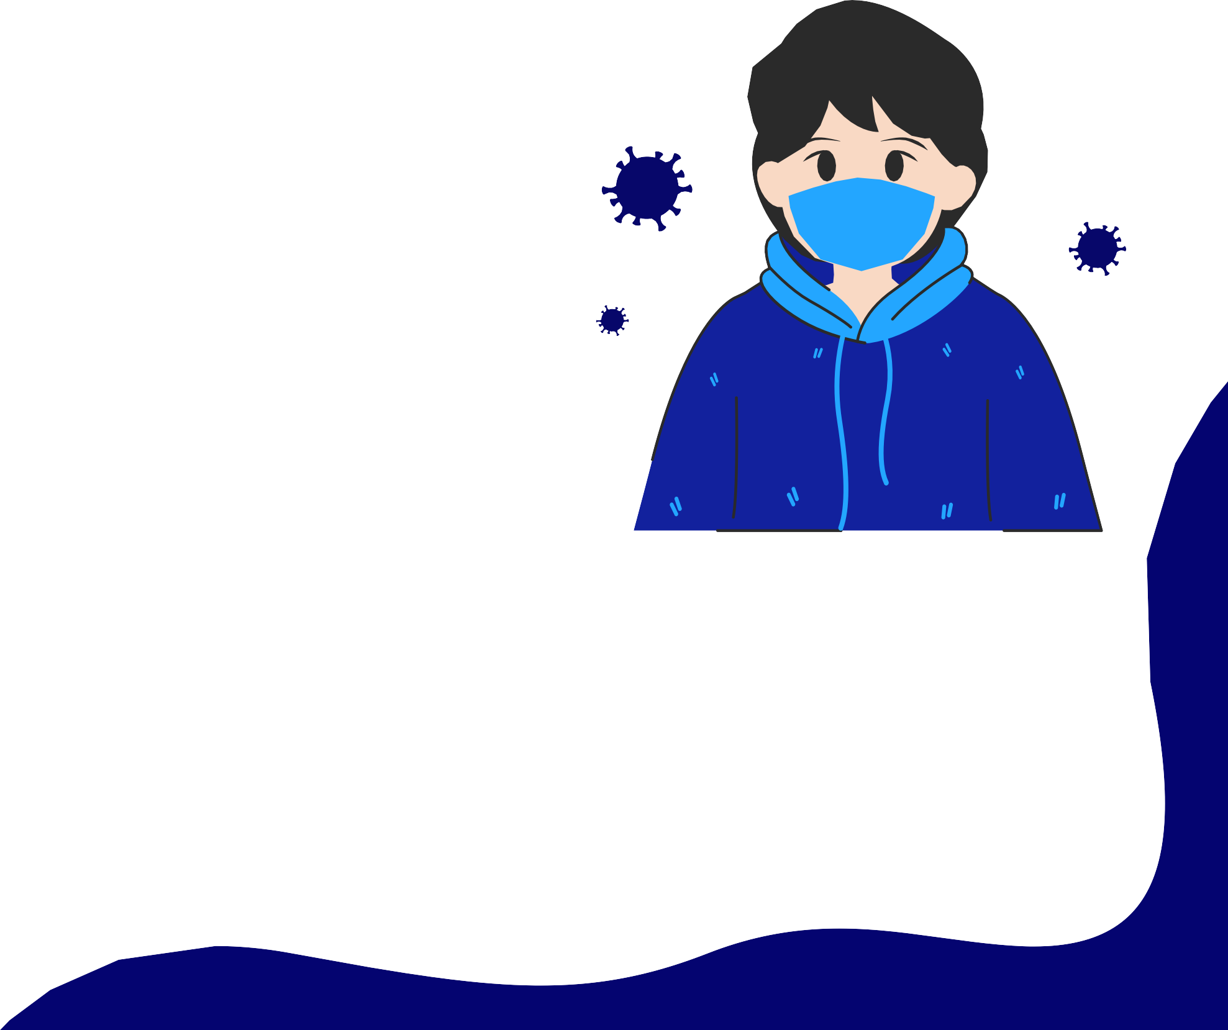
One of the problems users face when they need to diagnose whether they are infected with the coronavirus or have a heart condition is that they have two protocols to choose from.
01
The first protocol is PCR, which provides quick but less
accurate results.
02
The second protocol involves lung imaging, which is costly, time- consuming, and requires a doctor's intervention
Both protocols have their advantages, but they also have drawbacks. Therefore, it is important for us to develop a new protocol that assists users in diagnosis.

Slide 12

04
PROBLEM SOLUTION

Slide 13


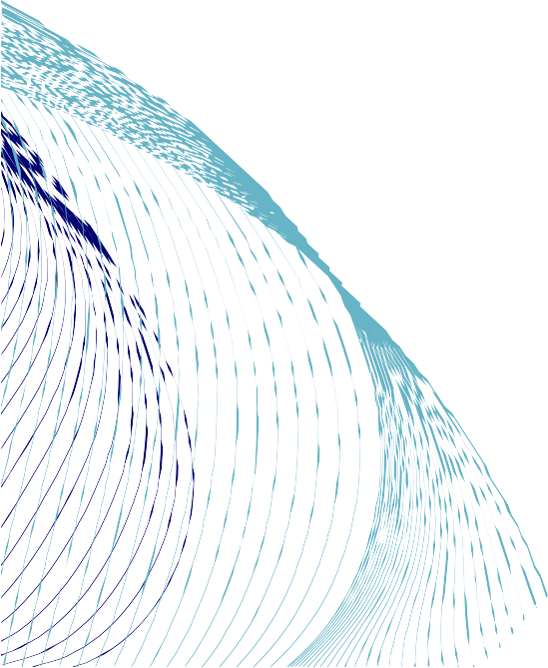
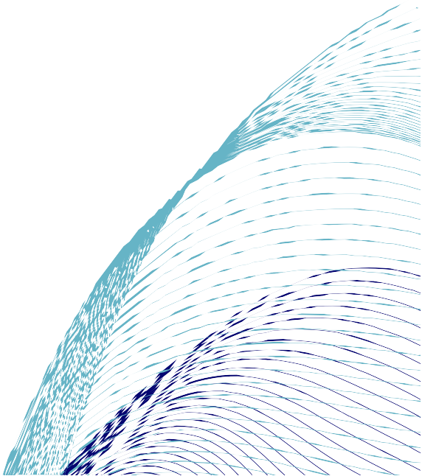
SOLUTION
we developed a website that assists users in diagnosing these diseases by using ECG images
This helps guide treatment faster, improving chances of recovery and prevention
This method saves the user time, effort, and money, providing accurate and quick results

Slide 14
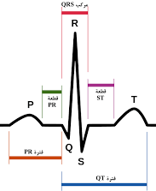
Electrocardiogram (ECG Signals)
(ECG) signals are considered one of the most important attributes for continuous monitoring of the human health.
The ECG signal consists of five main peaks which are the P, Q, R, S, and T.
The ECG technology depends on the electrical impulses of the heart.

Slide 15
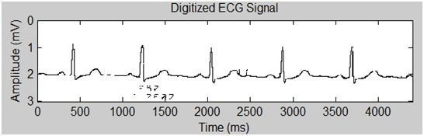
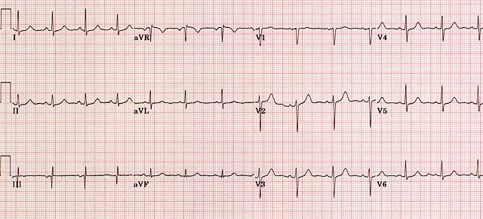
Electrocardiogram (ECG Image)
ECG can be represented in various shapes. One of these shapes is the digitized form of the ECG.
Another shape or form that describes the ECG is the ECG graph or the ECG tracing.
ECG paper reports are printed in the form of graph paper to achieve an accurate interpretation

Slide 16

05
Related work

Slide 17
No classes and leads
Types of ECG classes
Number of ECG image Reports or Recorded Images
Authors
Methodology
Results
1ˢᵗ dataset: 27,820 image reports.
2ⁿᵈ dataset: 33000 image reports
Discovery of weak supervised and
spatial attention part
+ recurrent label
inference
1ˢᵗ dataset: A = 79.23%
F1-Score: 73.88%
2ⁿᵈ dataset: A= 90.42%
F1-Score: 86.87%
Du et al.
2020
20 classes
12- ECG leads
20 ECG class types
Xie et al.
2021
Train: 90
Test: 8
A = 85.82%
20 classes
12- ECG leads
98 ECG image reports
Proposed Dense Net architecture
Normal, Stroke
Gliner et al.
2020
41830
Digital and Image leads
Training and validation = 86%
Testing = 14%
A = 88%
8-classes 12- ECG leads
AF, I-AVB, LBBB, RBBB, PAC, PVC, STD, and STE
CNN-ima and CNN-dig
Normal Abnrmal Mycrocardial
History of Microcardial Covid_19
Mask and CNN Modal (inception_v3)
Train=97.5% Test=97.2% Validation=97.7%
OurTeam
5 Class
8350 Images

Slide 18
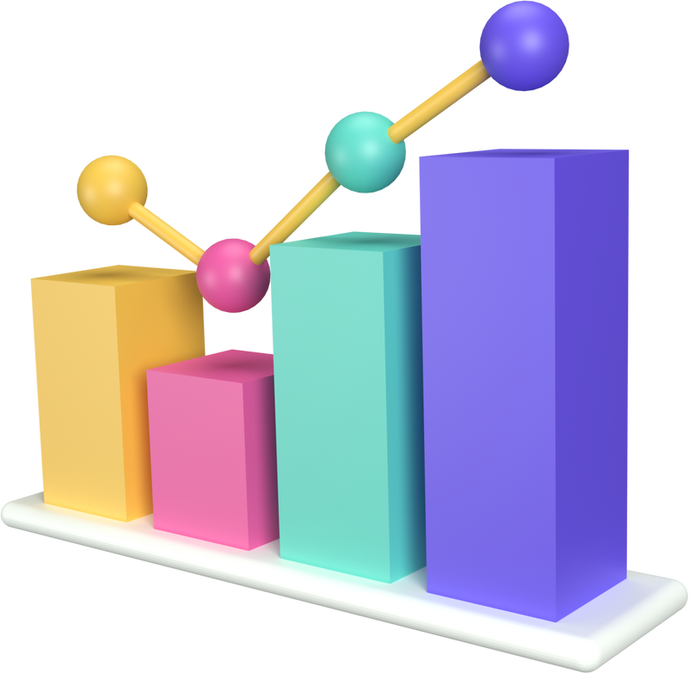
06
DATASET

Slide 19
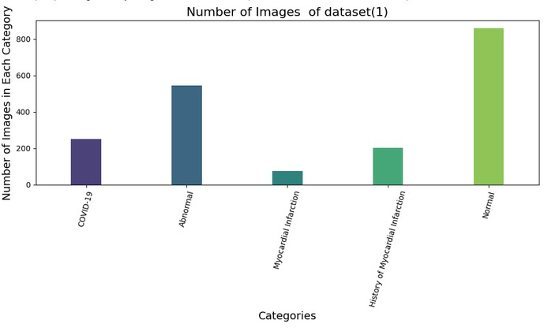
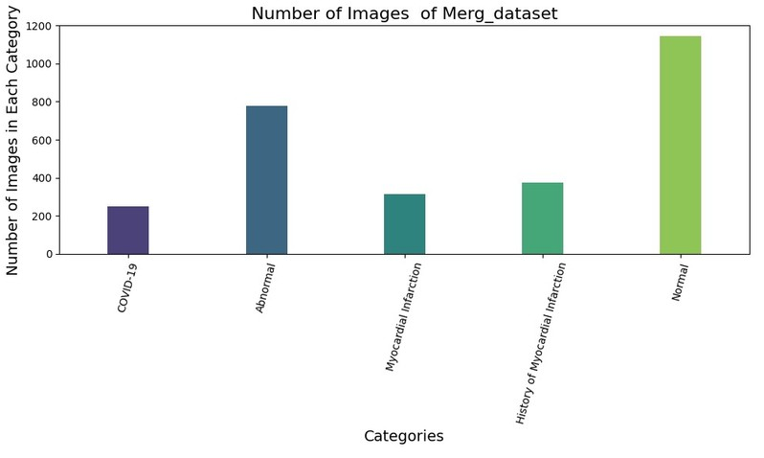
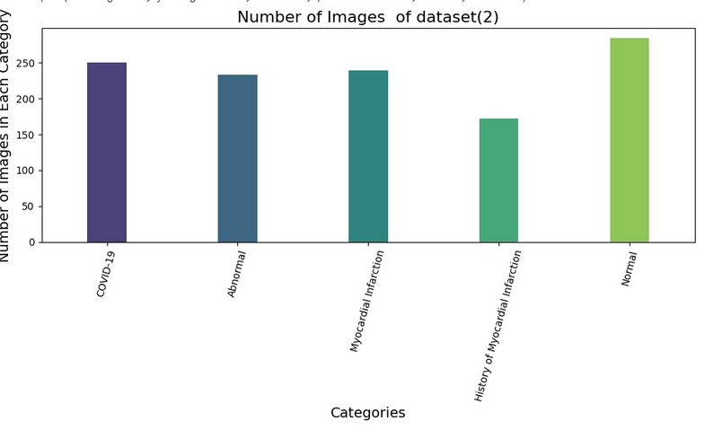
Dataset Information
Our dataset consists of five types of ECG (Electrocardiogram) images.
Dataset(1)
Merg Dataset
Dataset(2)
Total Number of ECG Images is 1932
Total Number of ECG Images is 2860
Total Number of ECG Images is 1178
This dataset consists of ECG images collected from two countries China and Pakistan.

Slide 20

07
IMPLEMENTATION

Slide 21
Image preprocessing
is the first step in implementing the model, where we prepare the data by applying image filters to improve the quality and suitability of the images for the deep learning algorithm.

Slide 22
Image preprocessing
Remove Background
Rescale
Remove Noise
Resize
Data Augmentation

Slide 23
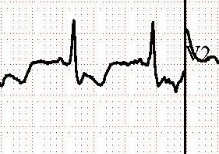
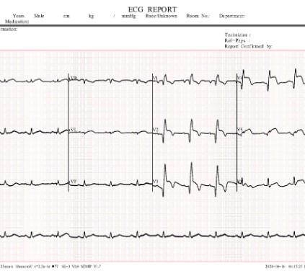
Image Preprocessing
1-Remove
Noise
Removing noise from images is a crucial step in image processing to improve the overall quality and clarity of an image
Noise in images refers to random variations or unwanted disturbances in pixel values, often introduced during image acquisition , transmission, or processing.
To enhance the accuracy of our image processing, we must address the noise present in the header and footer. This noise can take the form of text, logos, or other visual elements that are not part of the main image content.

Slide 24

TECHNOLOGY USED FOR REMOVING NOISE
we use Bilateral Filtering to
remove noise
03
02
It considers both spatial closeness and
intensity simil arity.
01
is a non- linear method that smoothens
the image while preserving edges.

Slide 25
Image Preprocessing
2-Remove
Background
This process is essential to enhance the visibility of key information with in ECG images, improve analysis accuracy, and facilitate the classification of patterns present in ECG.
Removing the background is necessary to enhance the performance of models.
Technology used to Removing background
1- Segmentation
is attempts to partition the pixels of an image into groups that strongly correlate with the objects in an image Then it's easy
to extract it from a background

Slide 26

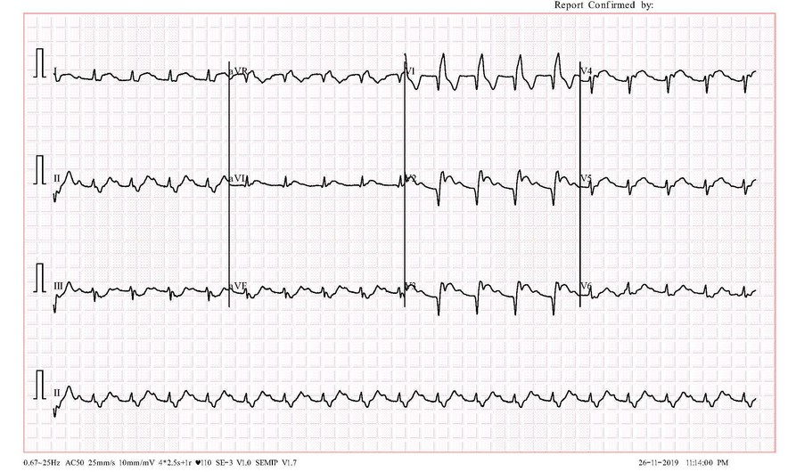
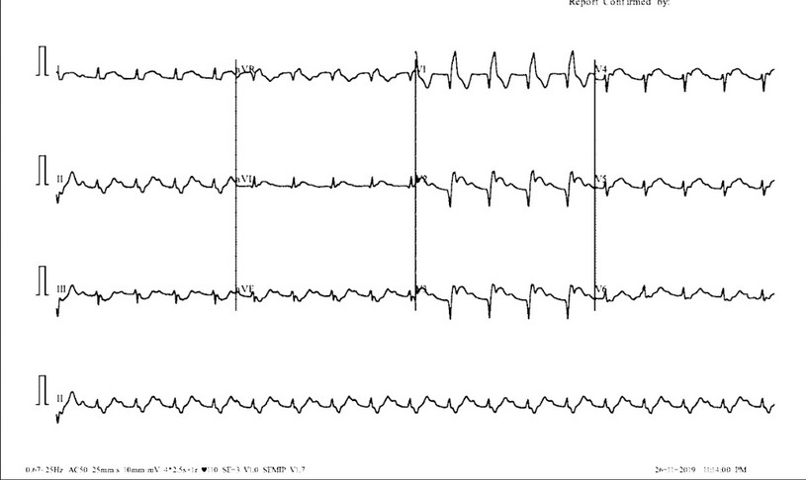
In the process of segmentation, type of thresholds
are used
binary with Otsu’s
Before
After

Slide 27
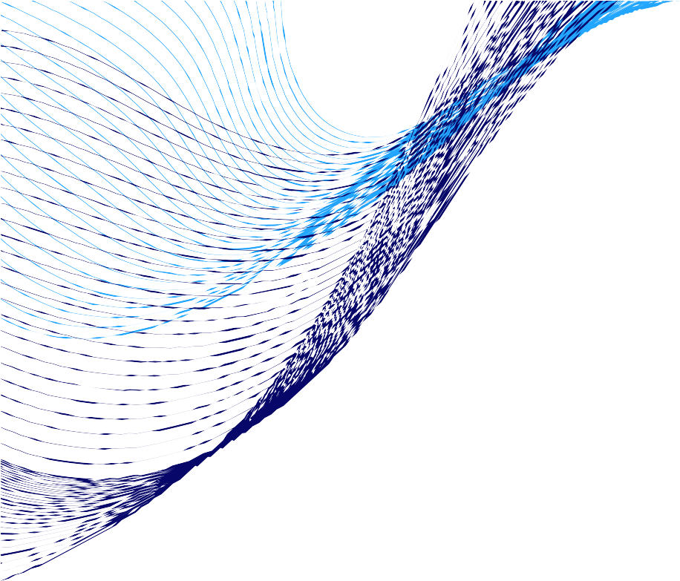
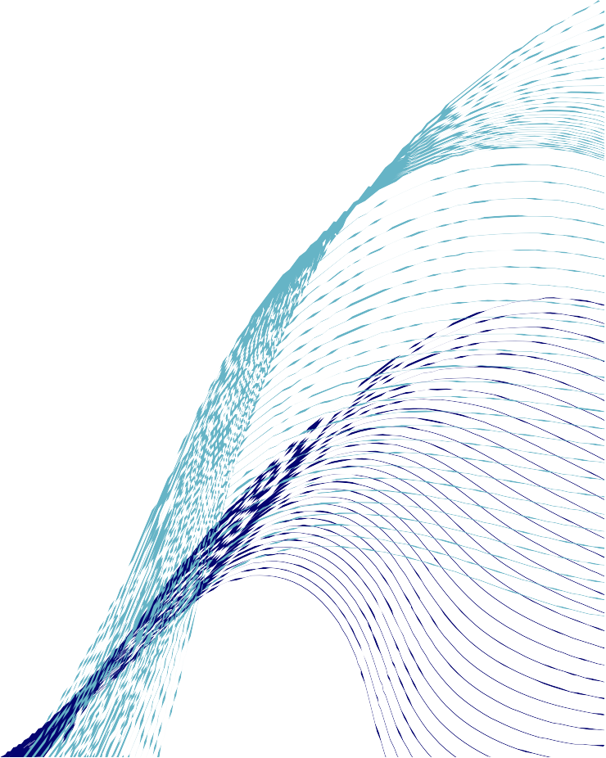
To improve the accuracy, we used a mask to remove the background.
2- mask
is a binary image used to identify specific parts ofanother image. The values in the mask are either 0 (black) or 255 (white), where white represents the areas we want to keep or process, and black represents the areas we want to ignore or exclude.

Slide 28







steps to create the mask
01
Define Color Bounds:This helps us identify and isolate the white areas in the image which we consider as the background.
02
Create a Mask:we create a mask that highlights the white areas. This mask will be used to separate the background from the foreground
05
Prepare Background :We prepare a white background image that will replace the original background.
03
Morphological Operation
:We then apply a morphological operation to refine our mask, removing noise and small white points
06
Apply Mask to Foreground: Using the inverted mask, we apply it to the original image to keep only the foreground
04
Invert the Mask :To focus on the foreground, we invert the mask.
This will allow us to later combine the foreground with a new background
08
Combine Images :Finally, we combine the foreground and the new background to produce the final image without the original background.
09
Save the Final Image :We save the final image with the background removed, completing our background removal process
07
Apply Mask to Background:We then apply the inverted mask to our white background image.

Slide 29
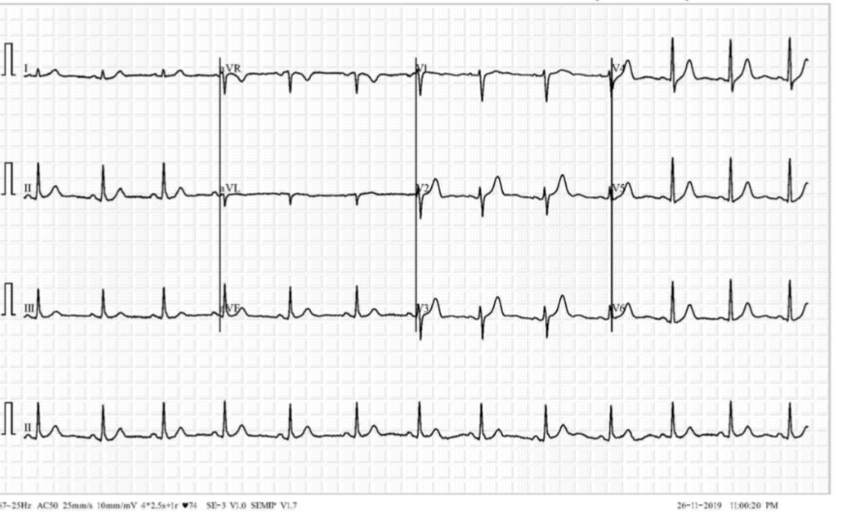
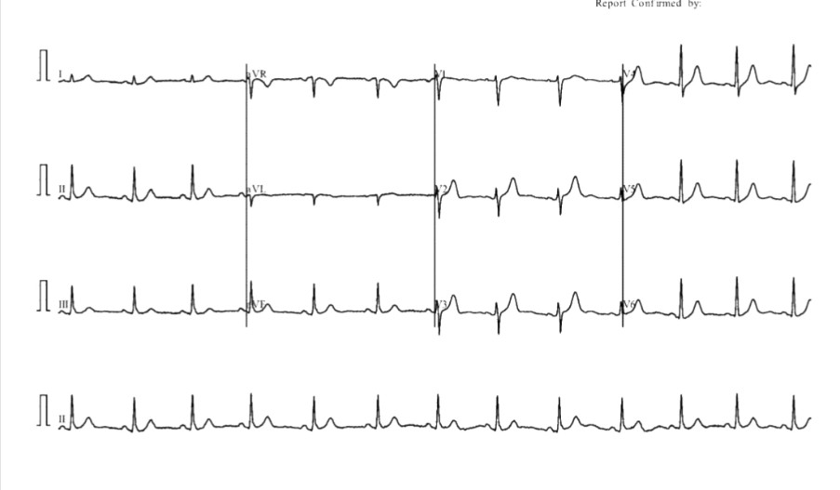
After
Before

Slide 30


Image Preprocessing
3. Resizing
Image resizing adjusts the dimensions of an image for consistency and efficiency in machine learning models, enhancing performance and
resource management.
4. Rescaling
Rescaling is adjusting data to a common scale, crucial for equal feature influence in machine learning. It enhances algorithm performance and ensures fair analysis.

Slide 31
Image Preprocessing
5.Data Augmentation
Deep learning technique requires much more training data than other machine learning approaches. In case where the data consists of images and not much data is available, image augmentation can be applied to increase the number of training examples and to avoid over fitting.

Slide 32



Techniques for Data Augmentation:
rotation_range=9 zoom_range=0.2
Image Data Generator Based On Geometric Transformations
brightness_range=(0.5, 1.5) horizontal_flip=True vertical_flip=True shear_range=0.085 width_shift_range=0.085 height_shift_range=0.085
Two ways
GAN-based Augmentation: Generative
Adversarial Networks (GANs) generate synthetic data that closely resemble real samples, effectively expanding the dataset.
Deep learning advanced
We don't have powerful devices on our team to support GAN technology, so we'll experiment with it in the second term.

Slide 33
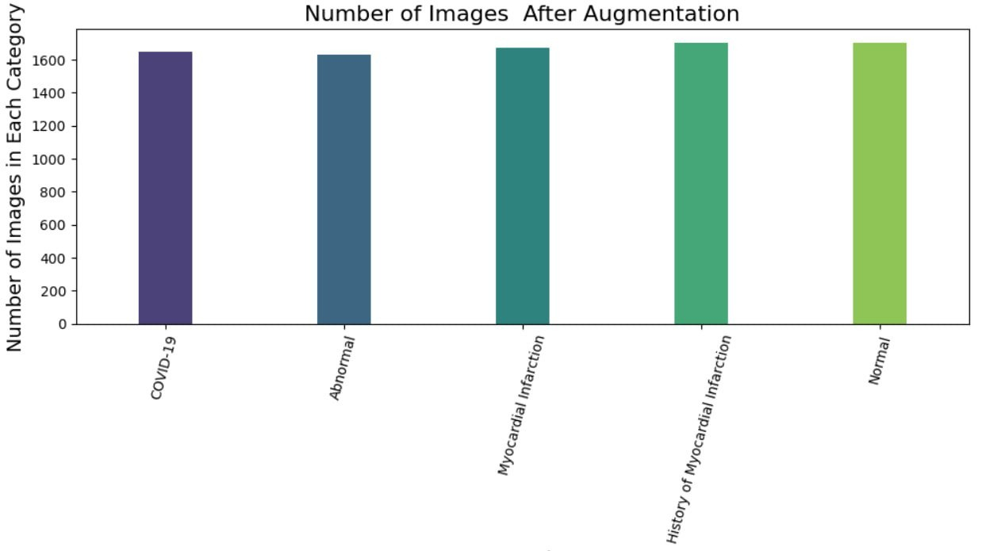
Total Number of ECG Images is 8350

Slide 34

Model Structure
09

Slide 35

WE DIVIDED THE DATA INTO THREE
DATA SETS:
70%
30%
15%
15%
TRAIN
TEST
VALIDATION

Slide 36
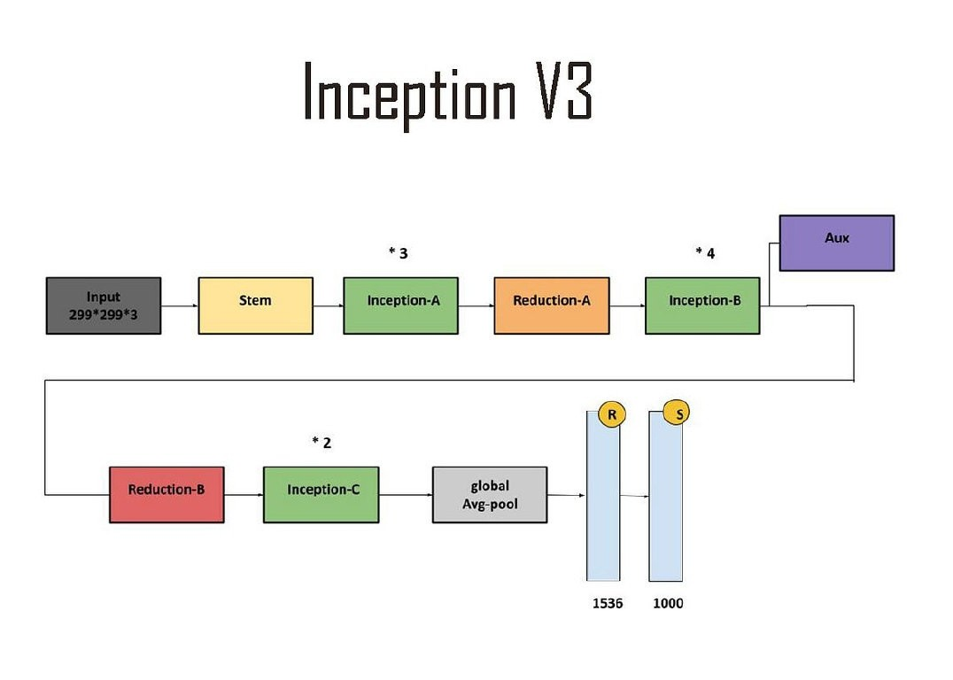
Utilization Model
the Inception V3 network, which is an advanced convolutional neural network (CNN) designed for image processing

Slide 37
Model Structure
inception A
A series of Inception modules of type A, which combine different convolutional operations (such as (1*1), (3 * 3), and 5 * 5)) to capture various features from the data.
Auxiliary Classifier:
An auxiliary classifier used to provide additional training signals, helping to improve gradient flow during training.
- It consists of several convolutional and pooling layers, followed by a classification layer.
input :
stem :
The input is an image with dimensions (299 * 299 * 3).
The initial part of the network processes the input data to prepare it for the subsequent stages.
- It includes multiple convolutional and pooling layers.
Reduction-A:
Inception-B:
A series of Inception modules of type B, which include various
convolutional operations to deepen the network and
increase the complexity of the features learned.
A dimension reduction module of type A, aimed at reducing the spatial dimensions (height and width) while increasing the depth (number of channels)

Slide 38
Reduction-B:
Inception-C:
Global Average Pooling:
A dimension reduction module of type B, further reducing the spatial dimensions and deepening the network
A series of Inception modules of type C, continuing to apply various convolutional operations to capture more features.
A global average pooling layer, applied to reduce the spatial dimensions to 1, taking the average across each feature map.
- Outputs a number of features equal to the number of channels.
Fully Connected Layers:
Dropout laye :
Last fully connected laye :
Fully connected layers applied after global average pooling.
- Include a final layer that outputs probabilities for each class (usually
1000 classes for image classification in ImageNet)
use 5 neurons to make classification and use softmax classifier
use to remove neurons that have noise

Slide 39
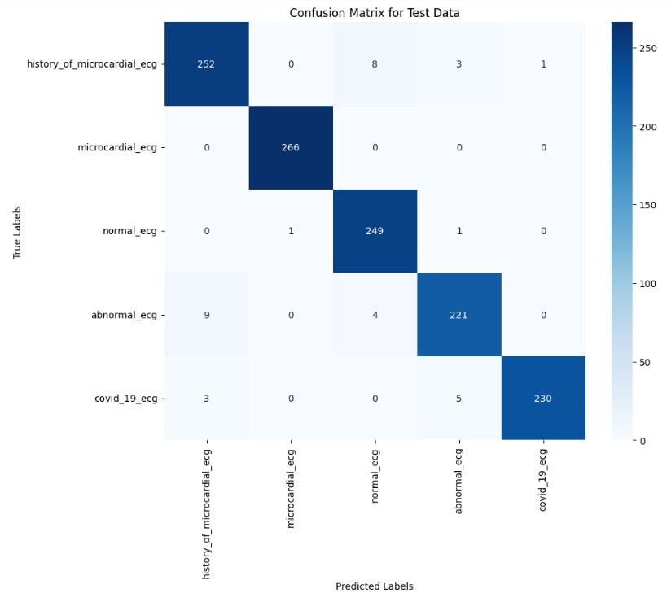
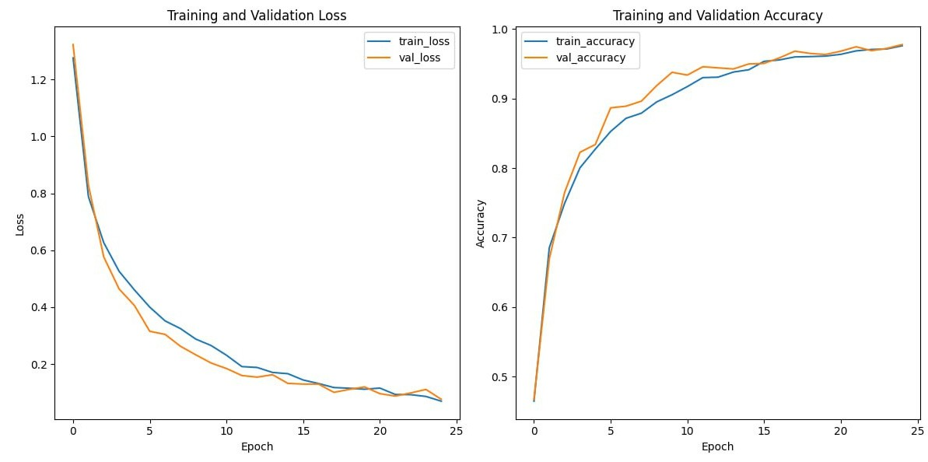
Confusion Matrix
Loss & accuracy

Slide 40

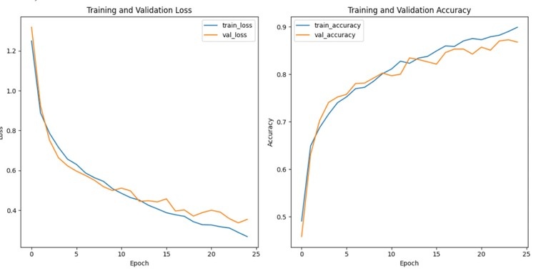
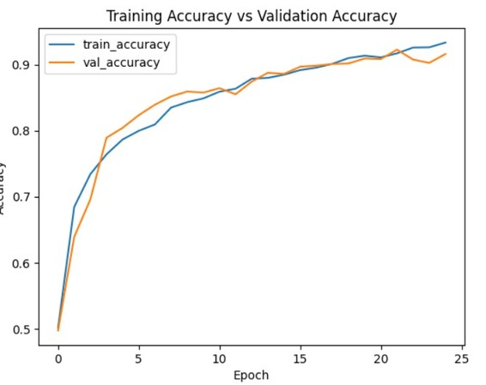
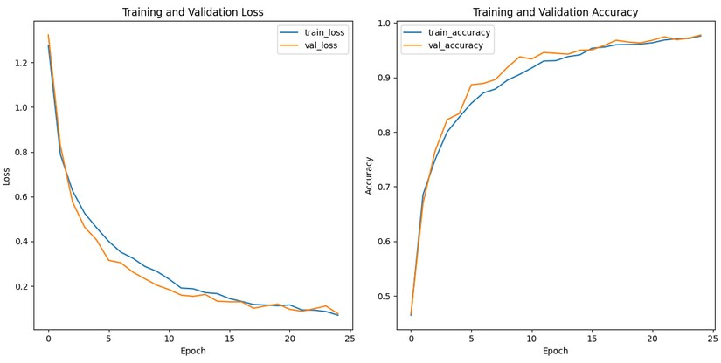
The comparison between two dataset
DataSet.1
MERG_DataSet
DataSet.2
Train Accuracy:89% Test Accuracy:87%
Train Accuracy:93% Test Accuracy:91%
Train Accuracy:97.5% Test Accuracy:97.2%

Slide 41



Comprsion between different models
Resenet_50
Inception V3
Vgg_19
Accuracy of train : 0.96%
Accuracy of train : 0.95%
Accuracy of train : 0.975%
Accuracy of test:0.95%
Accuracy of test:0.94%
Accuracy of test: 0.972%
Loss of train:0.24
Loss of train:0.13
Loss of train:0.06
Loss of test:0.27
Loss of test:0.14
Loss of test:0.09

Slide 42
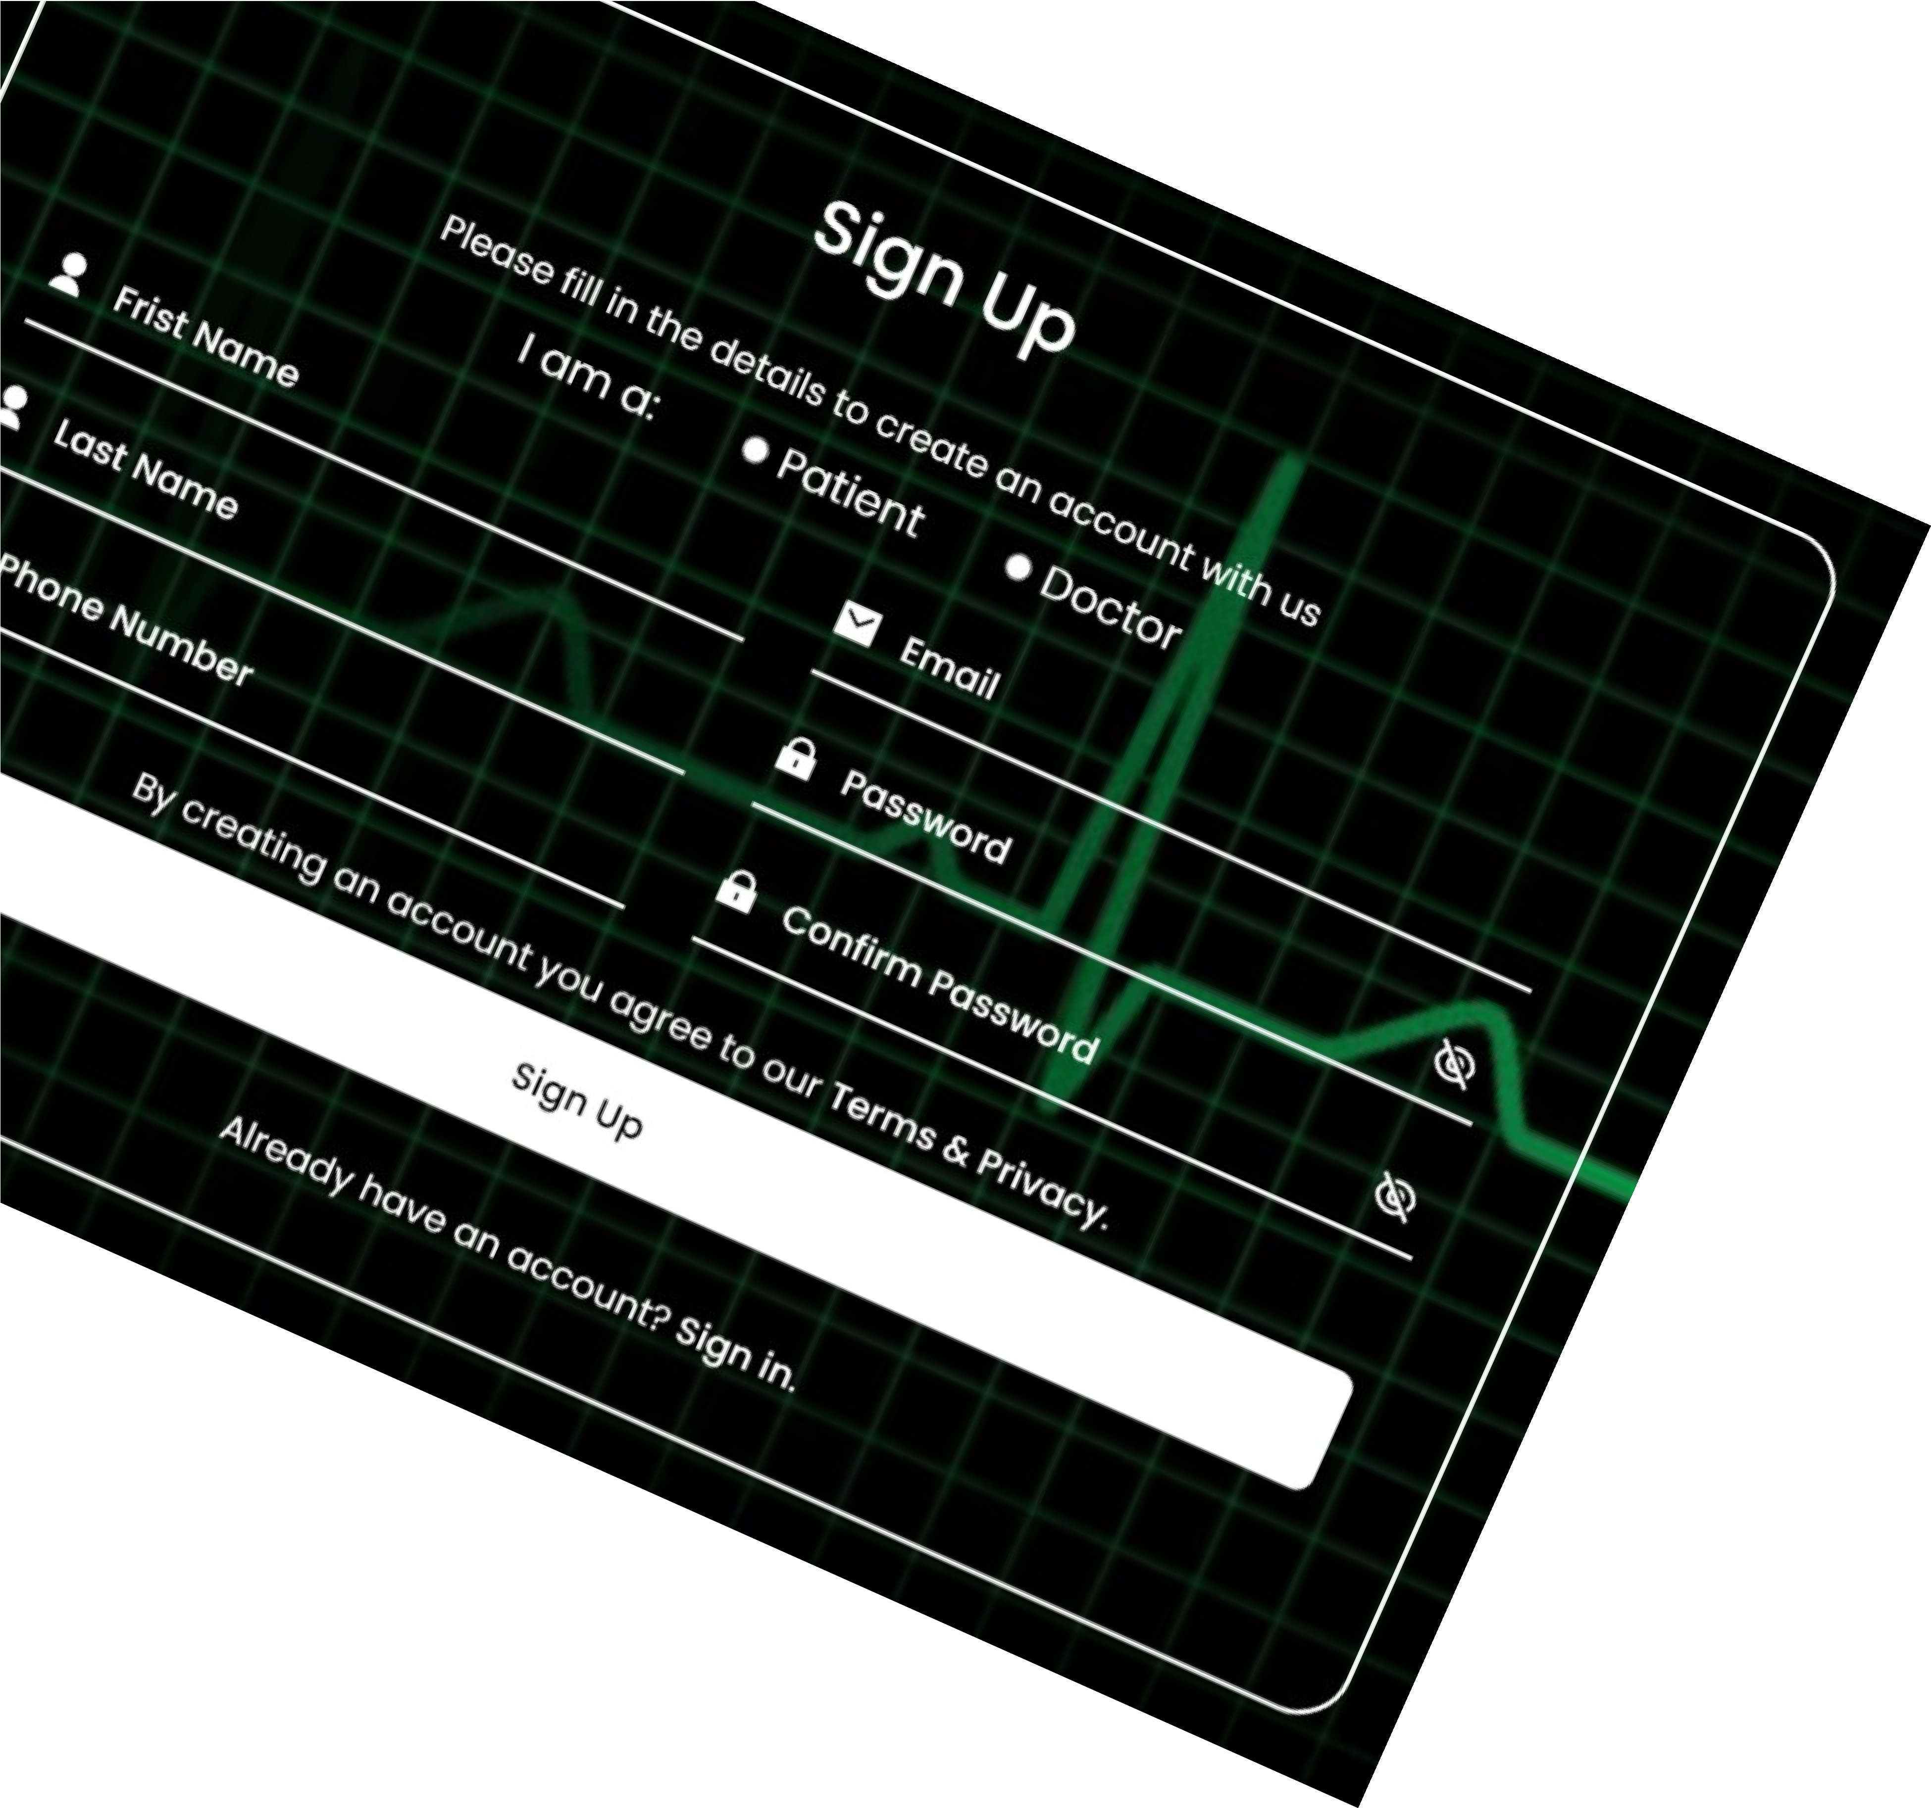
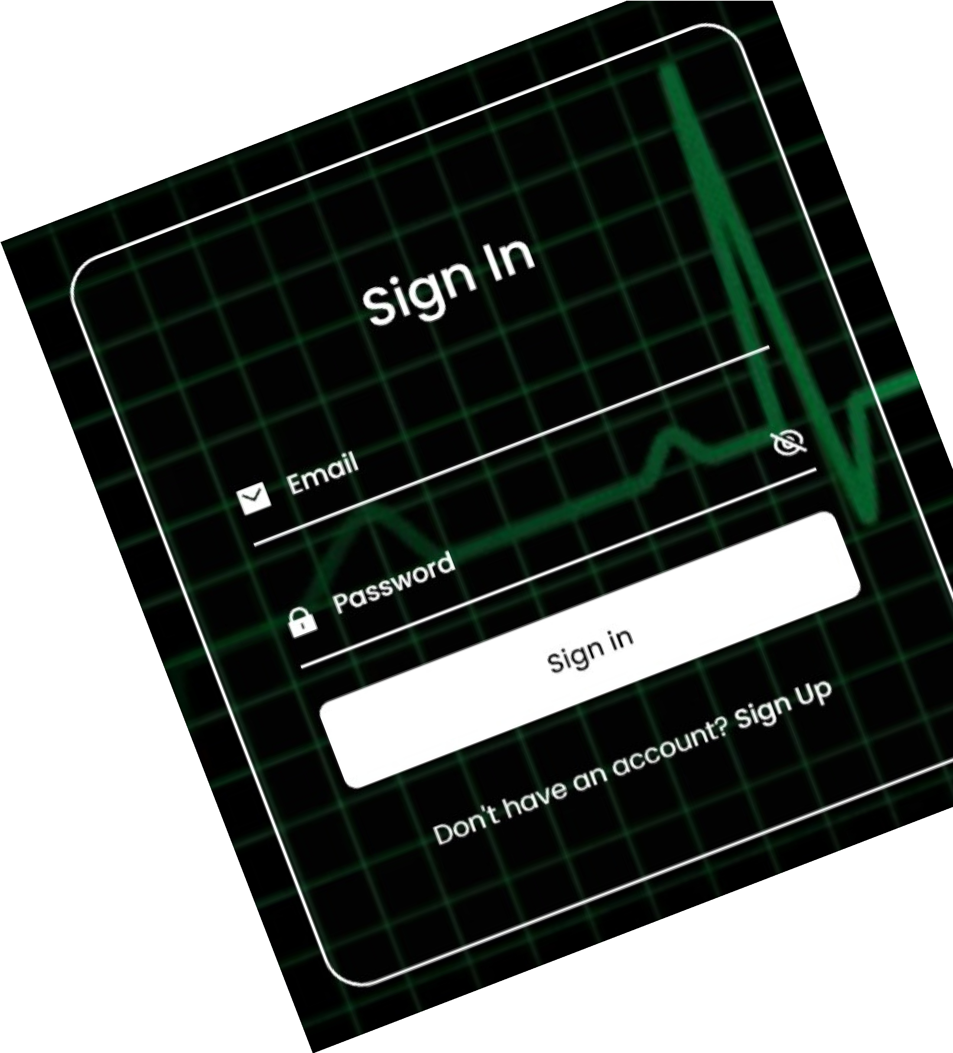
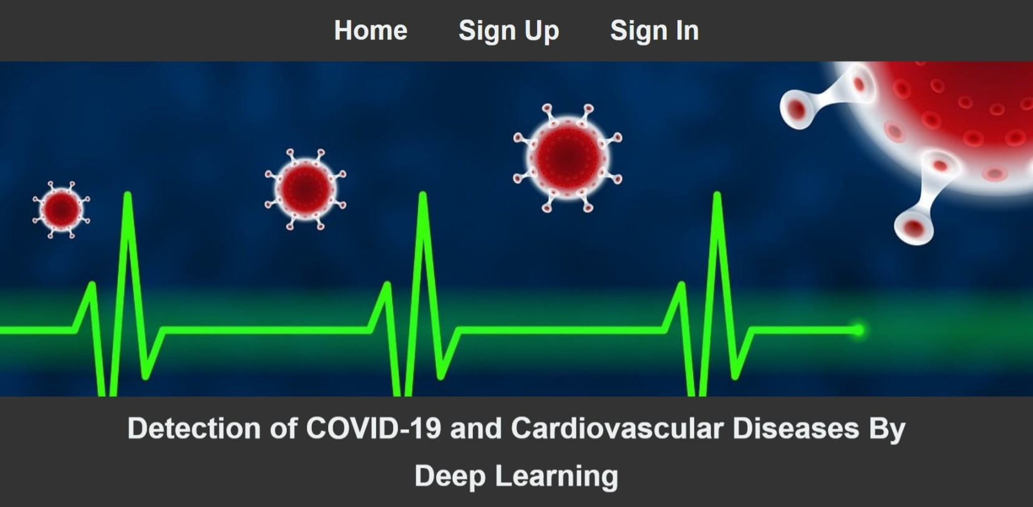
Sign Up or SIign In

Slide 43
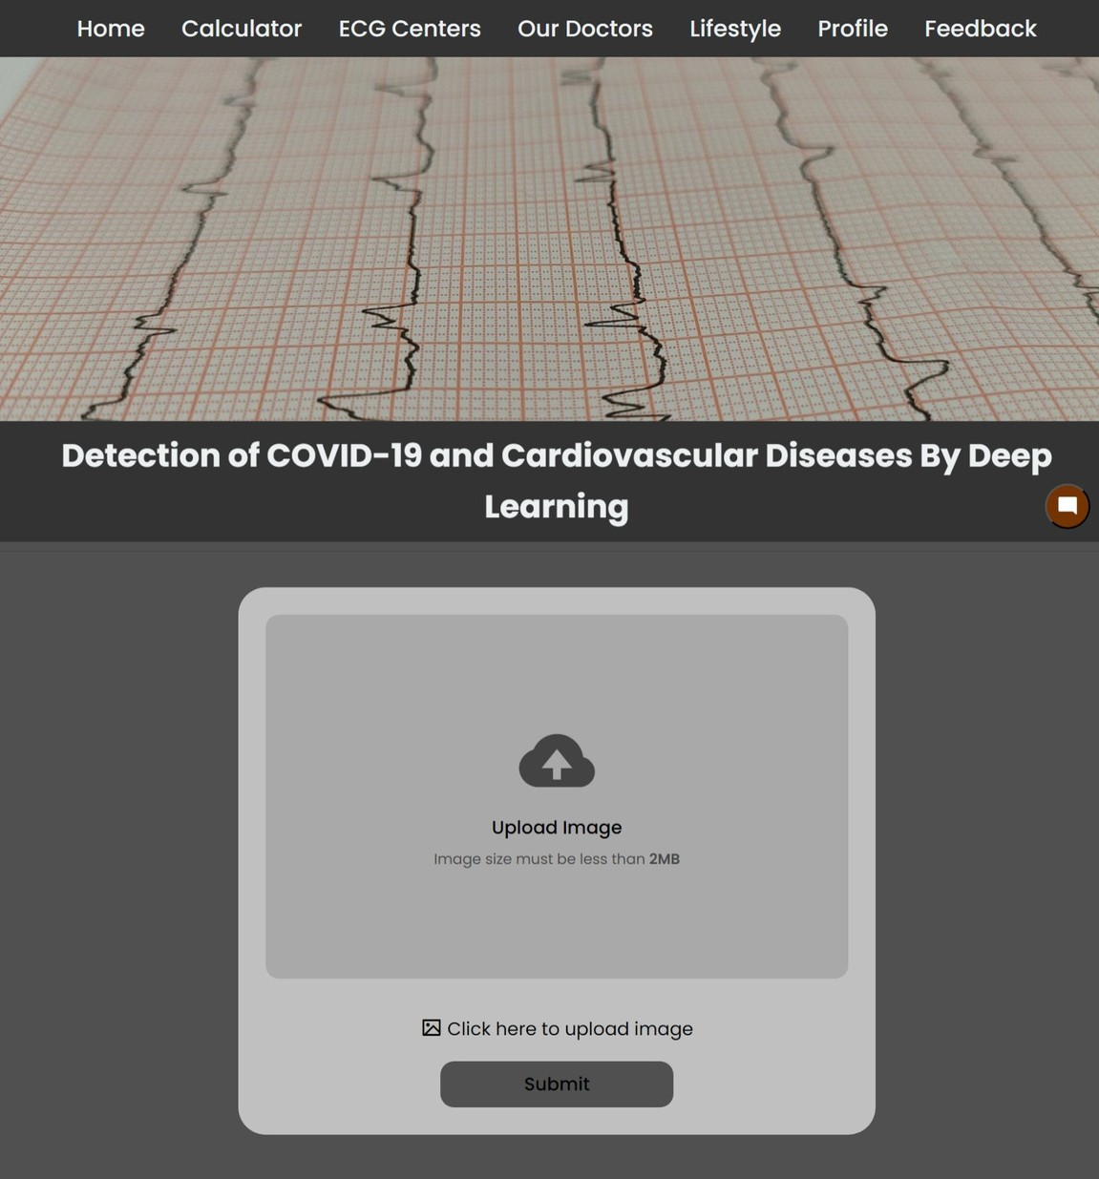
Upload ECG-Image

Slide 44
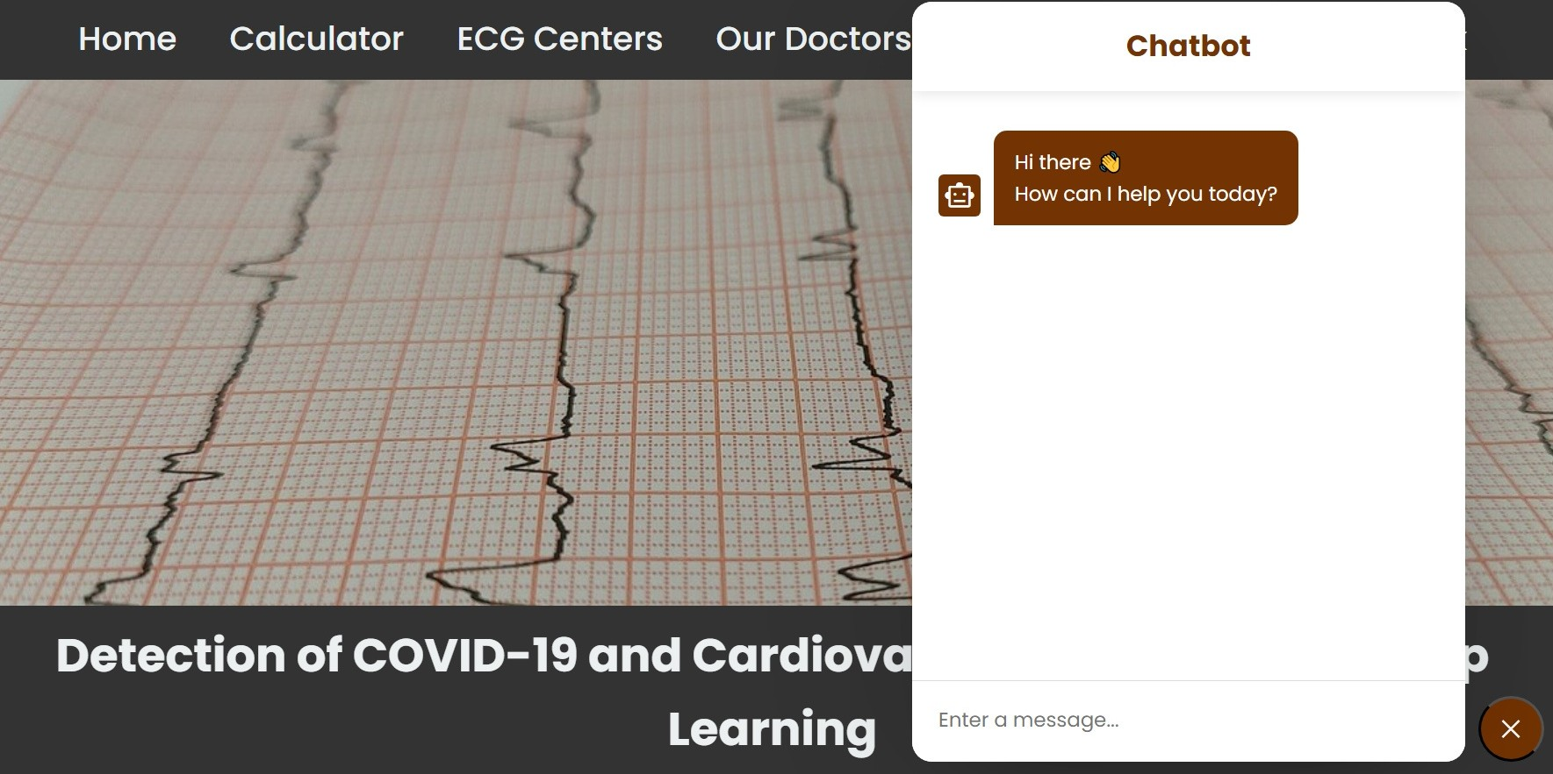
Chatbot for any Patient’s Question

Slide 45
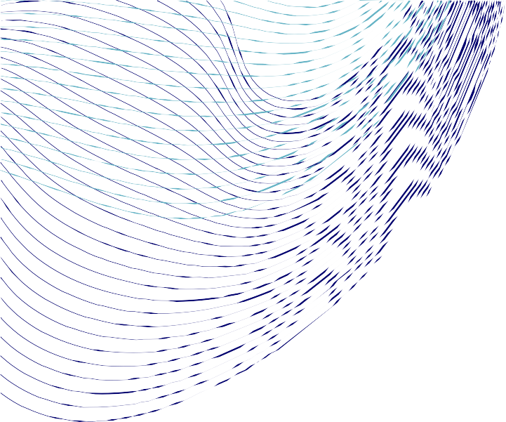
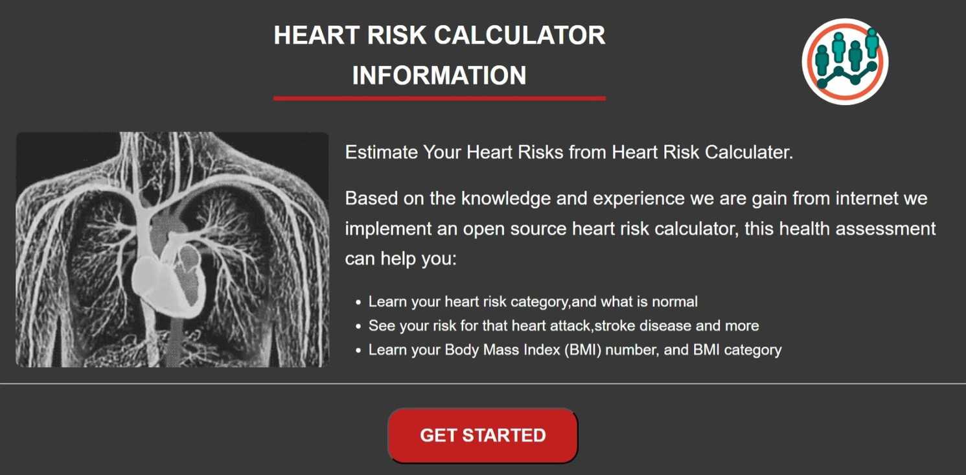
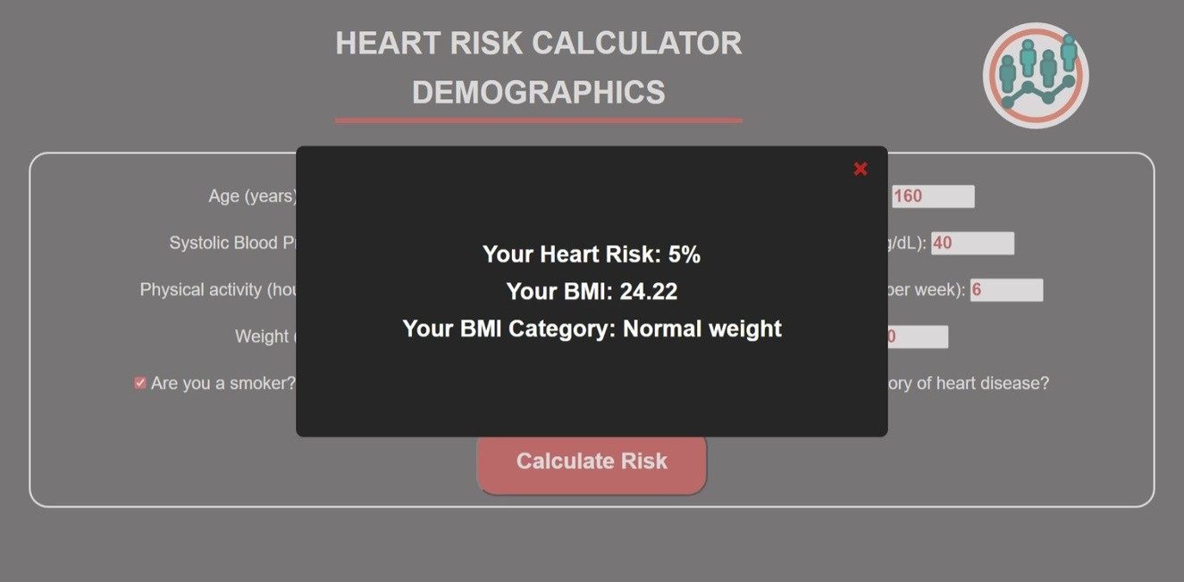
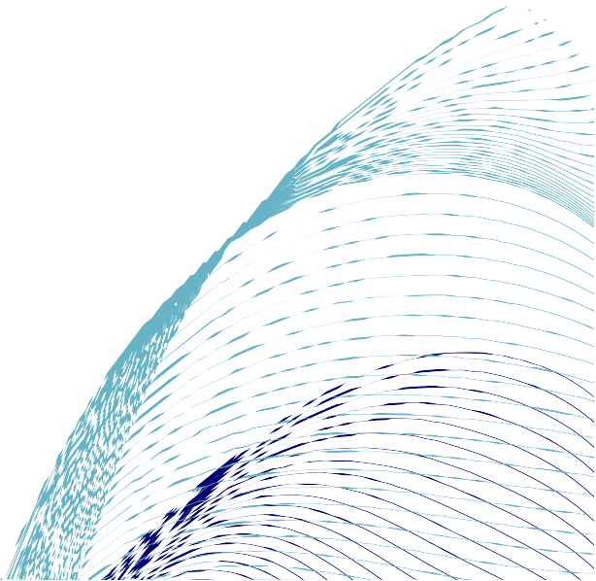
Risk Calculator

Slide 46
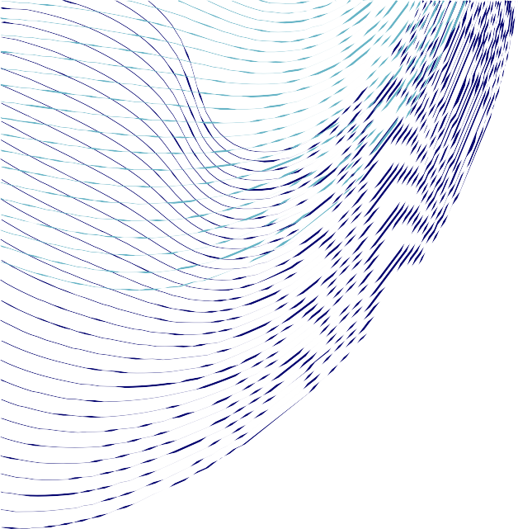
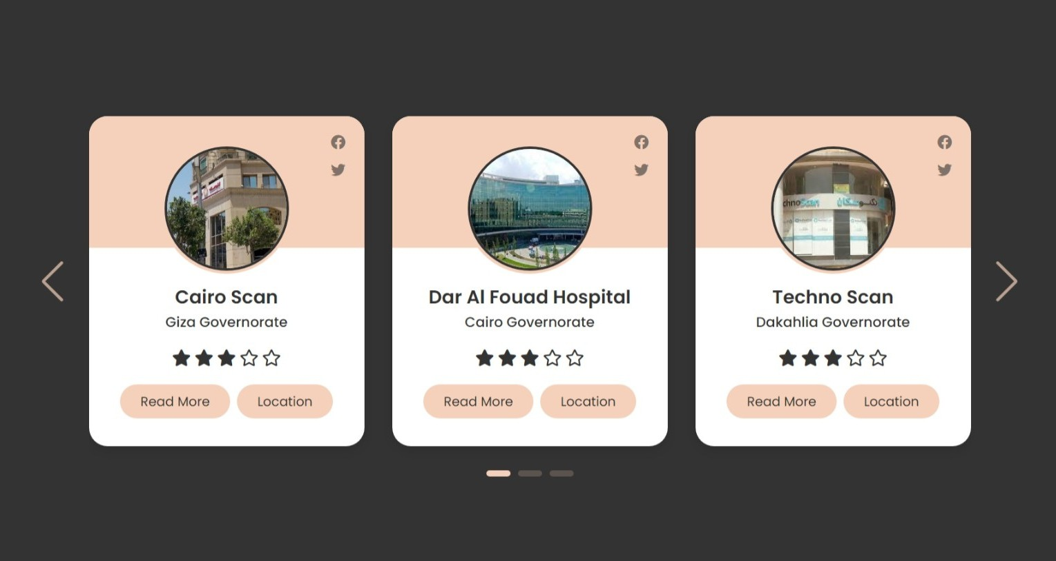
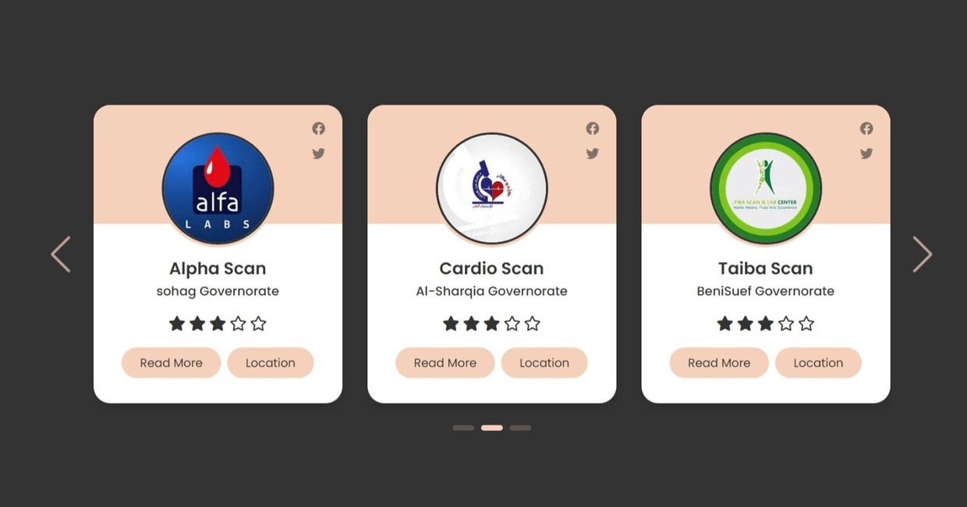
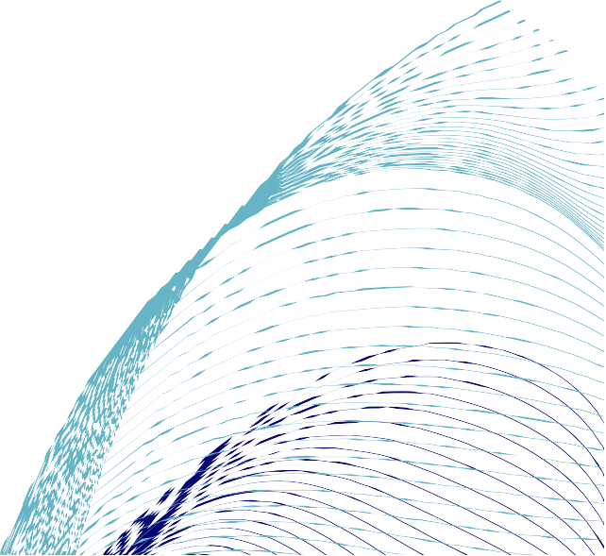
ECG-Image Centers

Slide 47
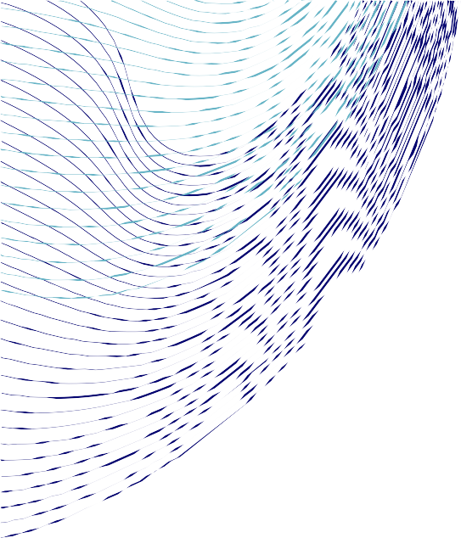

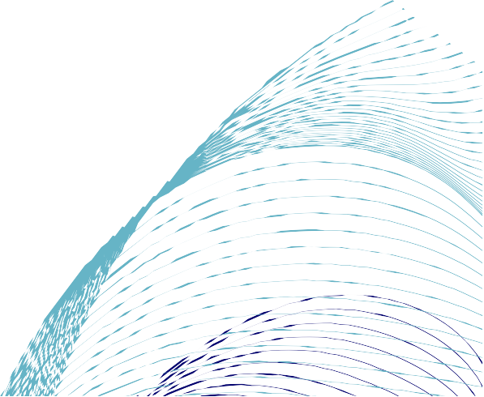
Our Doctors

Slide 48
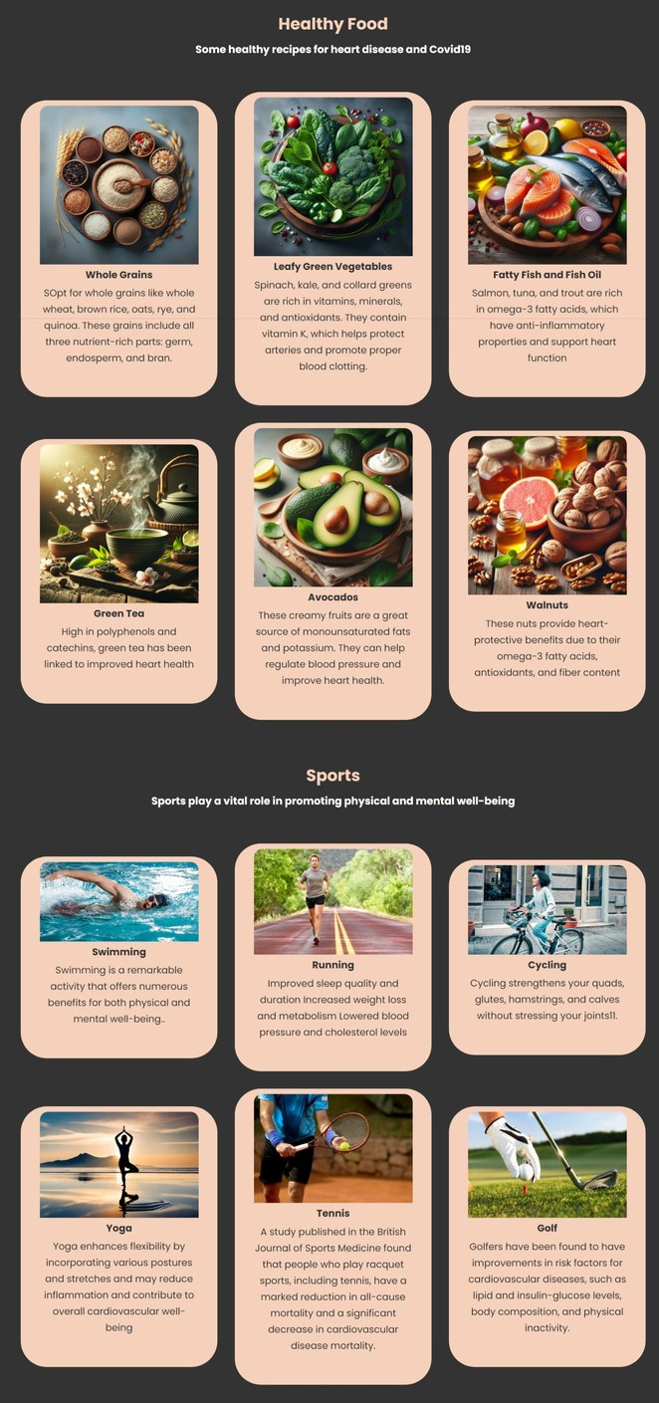
Lifestyle Page contains recommended
Healthy Food and Sports for Heart Patients and Covid-19 Patients

Slide 49
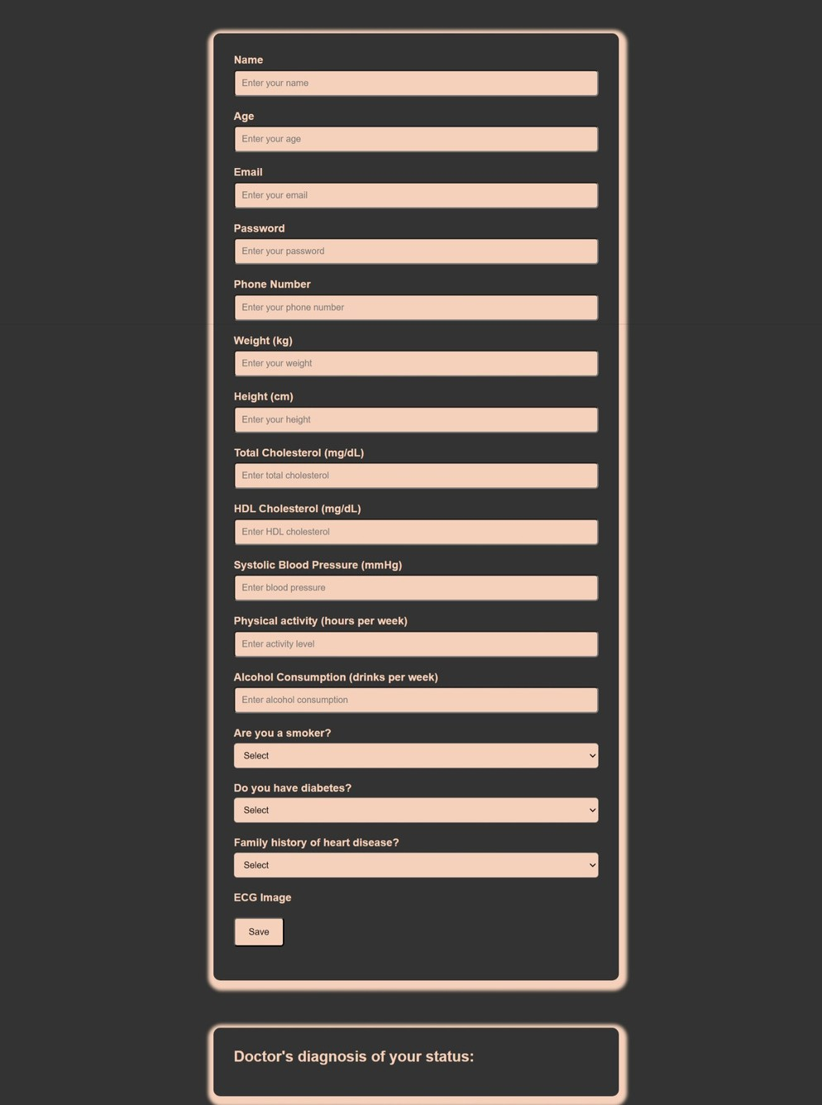
Patient Profile
contains all data that the patient entered on the website

Slide 50
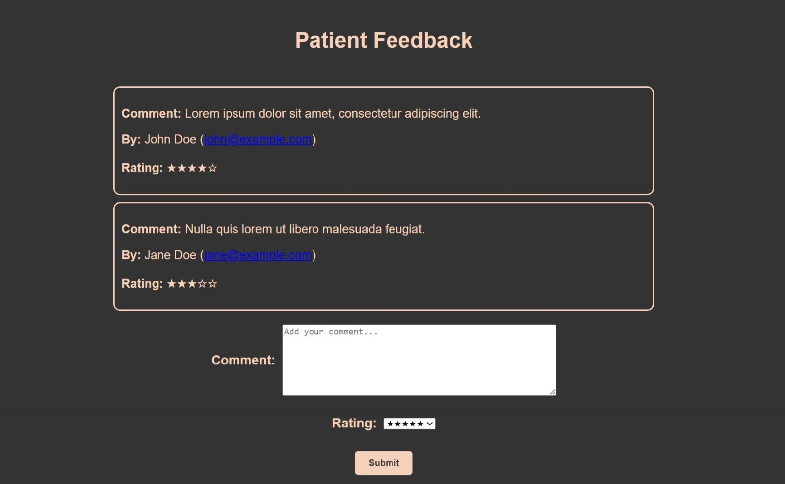
Comment and Evaluation of Patients for Website

Slide 51
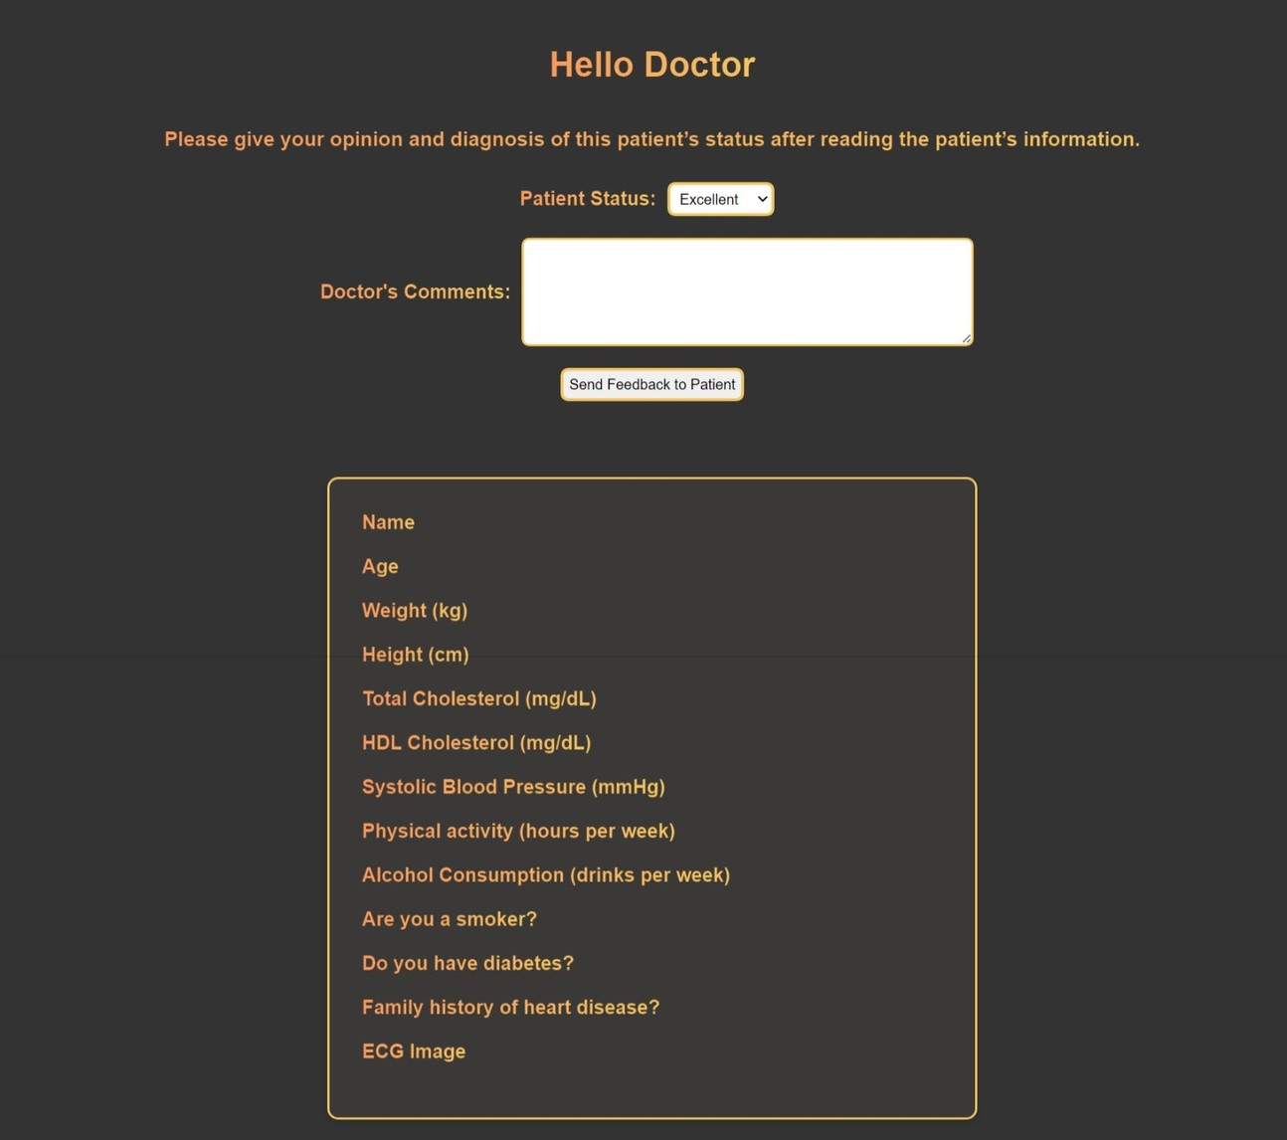
Doctor’s Diagonsis per Patient depending on his/her Status

Slide 52
Link model and make Api for website using flask
1
Create file “app.py” incudes the deep learning model
2
When user upload image in “upload.html” page that opens a POST request to the URL "http://127.0.0.1:5000/predict".
3
the Api will get photo and go to server of flask to get result by XMLHttpRequest
4
it retrieves the response text from the server When the request is complete to display the predicted category at same page.
5
The user can upload ecg image to check according to the division of types of ecg data

Slide 53
Architecture Overview
Flask
http://127.0.0.1:5000
Render
hosting server
django
http://127.0.0.1:8000/
API
Hosting
server
user
Model Training
website

Slide 54

Methodology
09

Slide 55


Structure System

Slide 56





Use Case Scenarios

Slide 57


class diagram
sequence diagram

Slide 58

Technologies
10

Slide 59








FRONT
BACK END
AI

Slide 60

TIME PLAN
11

Slide 61




Time plan
Research and understand the idea of the project
2 weeks
2 weeks
Understanding the dataset
Data visualization
2 weeks
4 weeks
-Preprocessing for data and augmentation
-Create a web site and create database in MySQL
Implementation and build the model.
Link model and make Api for website.
4
weeks
4
weeks
Improve accuracy
add new features to website
Obtain the final version of the project and to amend any proposals from the doctor and teacher assistant.
2 weeks

Slide 62


